Slide 1
Comic Book Reader Application
Chris Johnstone

Slide 2
Motivation
No working comic book app I am happy with
Aggravating interfaces with a lack of customization.
Very few have network support. Those that do I could not get working well.
CBR/CBZ is a popular format
CBR is a RAR archive of images, CBZ is a zip archive of images.
Other comic book apps are mostly free with ads, which isn’t worth it. I’d prefer to pay and have an ad-free experience.

Slide 3
Proposal
To develop an Android-based smart phone application that allows the user to view comic book archives, and to load those archives from network locations.

Slide 4
Application Features
Clean, non-intrusive interface. The only thing that should be on screen is the comic and a background color when needed. This color should be customizable.
Network support
Download comics from network shares to your phone. Manage this library of downloaded comic files. Connect to your network shares when away from home via IP address.
FTP support
Tablet support

Slide 5
Phone Requirements
Support for as many Android phones and tablets as possible. An old tablet would make a great comic book viewer, so supporting keeping the minimum Android version as low as possible is a priority.
API 15 (Ice Cream Sandwich) runs on approximately 100% of devices and will be the initial target.

Slide 6
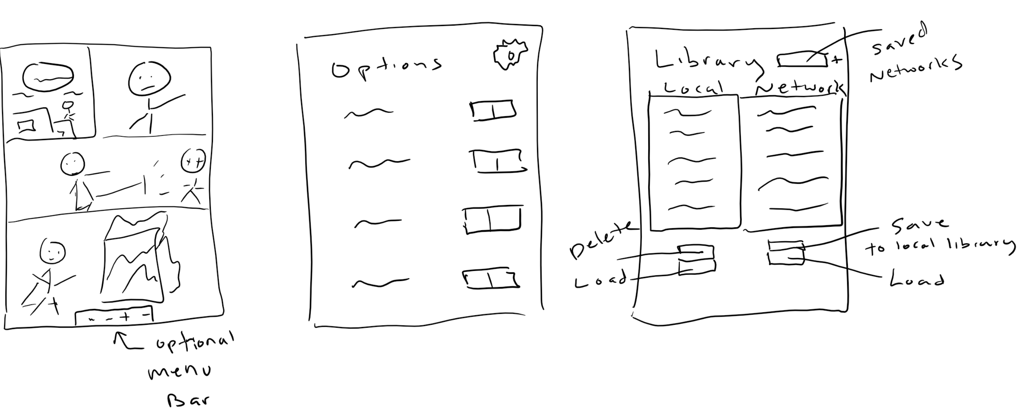
Mockups

Slide 7
Project Timeline
This project will be due in May 2018.
Build as complete a project as possible by then and continue beyond the deadline

Slide 8
Anticipated Deliverables
First goal:
Open and read a .CBZ file, display it on the screen, and make it so the user can read the comic
Second goal:
Implement options: swipe gestures, background color, toolbar visibility, etc.
Third goal:
Implement the same with a .CBR file. This uses the RAR format which does not look as easy to implement as ZIP.
Fourth goal:
Implement network features.

